Slide 1
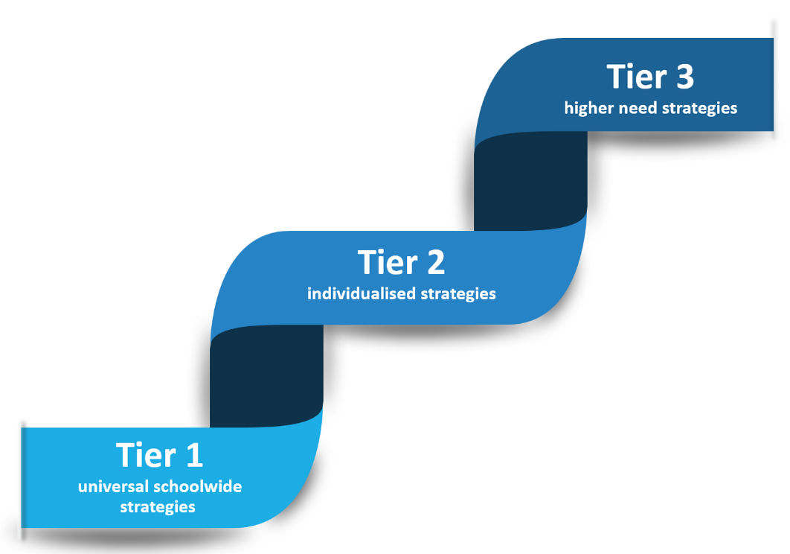
A Multi-Tiered System of Support (MTSS) for school attendance involves three tiers of intervention, with roles for teachers, the school, children, parents and external agencies – including the Local Authority.
Data-driven decision-making and training requirements are pivotal to the implementation of the system.
The system aligns with the Department for Education's (DFE) "Working Together to Improve School Attendance" guidelines.
- Data Decision-Making: Regularly collect, analyse, and use attendance data at each tier to inform decisions and interventions.
- Training Requirements: School staff should receive appropriate training at each tier to effectively implement attendance strategies.
- External agencies: External agencies play a crucial role in data analysis, resource allocation, and training provision to support schools in improving attendance.
- Children and Parents: Effective communication and co-creation of any intervention support is pivotal to the success of the MTSS approach.

Slide 2
Role of Teachers and School
Meet and Greet children.
Create positive classroom environments.
Build positive relationships with all children and adults.
Recognise individual and collective achievements.
Implement evidence-based teaching strategies.
Address barriers to attendance – adapt lessons to meet needs
Monitor daily attendance and punctuality
Promote the importance of attendance
Collaborate with the whole school community
additional support.
Role of Children
Take responsibity - Attend school regularly and be punctual.
Engage actively in classroom activities.
Support other children.
Recognise the achievements of other children.
Share when you have a concern.
Tier 1
Universal
Strategies
Role of Parents
Ensure children attend school regularly and on time.
Understand and support any concerns your child may have.
Communicate with the school regarding absence.
Recognise personal achievements.
Communicate with teachers about any concerns.
Promote the value of regular attendance
Lead by example.
Role of External Agencies
Provide resources and training to teachers on effective classroom strategies.
Collaborate with schools on attendance initiatives.
Support a comprehensive and inclusive school-wide approach that encompasses both attendance and mental health.

Slide 3
Role of Teachers and School
Proactively use data information to identify children who are PA and at risk of PA.
Work with each identified child and families to understand and address the reasons for absence, including any in-school or out of school barriers to
attendance.
Implement agreed strategies in daily practice.
Monitor progress.
Recognise achievements.
Role of Children
Co-create and participate in any targeted interventions.
Recognise personal achievements.
Share concerns with staff.
Continue to engage in school life.
Tier 2
Individualised Strategies
Role of Parents
Work with the school to help understand their child’s barriers to attendance.
Proactively engage with the support offered to prevent the need for more formal support.
Continue to communicate effectively with the school regarding absence.
Role of External Agencies
Signpost or provide access to services.
Where there are out of school
barriers, provide each identified child
and their family with access to
services they need.
Provide professional development and early intervention support to the school.

Slide 4
Role of Teachers and School
Take an active part in the multi-agency effort with the local authority and other external partners.
Use data driven information to identify children at risk of severe absence.
Continuously assess and adapt strategies. Monitor progress.
Recognise achievements.
Role of Children
Actively engage in intensive interventions. Recognise personal achievements.
Share concerns with staff.
Continue to engage in school life.
Tier 3
Higher Needs Strategies
Role of Parents
Collaborate closely with the school on creating and implementing highly specialised interventions
Continue to communicate with the school.
Take an active role in the multi-agency effort.
Role of External Agencies
Offer specialised assessments and services for students with complex needs.
Provide intensive training and consultation.
Take an active part in the multi-agency effort with the school and other external partners.

